Slide 1
NiosTM Advanced Training
SESSION I
Interrupt Routines Implementation

Slide 2
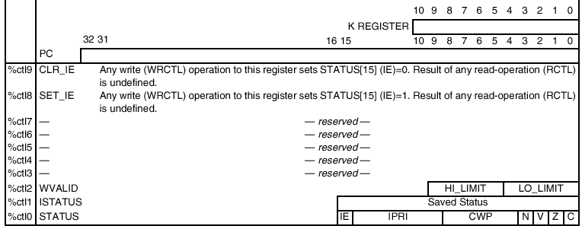
Programmer's Model

Slide 3

Exceptions
External Hardware interrupt Sources
  External logic for producing the 6-bits interrupt
  number & asserting the IRQ input pin is automatically generated by the SOPC builder and is included in the Peripheral Bus Module (PBM).
Internal Exception Sources
  2 sources of internal exceptions
    Register window-overflow
    Register window-underflow
Direct Software Exceptions
  Software can request that control be transferred to an exception handler by issuing a TRAP instruction.
  IMM6 field of the instruction gives the exception number which will be always processed, regardless of the setting of the IE or IPRI bits.

Slide 4
External Hardware Interrupts
Active-high interrupt signal: irq
  Level sensitive
  Sampled synchronously at the rising edge of Nios clock
  Should stay asserted until the interrupt is acknowledged by software
6-bit Input Interrupt Number: irq_number[5:0]
  Identifies the highest priority interrupt currently requested
    Highest priority = 0 (irq #0 to #15 are reserved)
    Lowest priority = 63
Nios will process the indicated exception if
  IE= 1 – i.e. external interrupts & internal exceptions are enabled, AND
  The interrupt number is smaller (lower or equal) than the IPRI field value

Slide 5
Interrupt Service Routine Handler
  nr_installuserisr( int trapNumber,
  void *ISRProcedure,
  int context)
trapNumber is the exception number to be associated with a service routine
ISRProcedure is a routine which has a prototype of
typedef void (*Nios_isrhandlerproc) (int context);
context is a value that will be passed to the routine specified by isrProcedure
This routine installs an interrupt service routine for a specific exception number
If nr_installuserisr() is used to set up the exception handler, then the exception handler can be an ordinary C routine

Slide 6
ISR Process
Memory
Main Program
Save
Context
Interrupt occurs
Current state is saved (Context)
ISR address is retrieved from the vector table based on the interrupt number
Jump to ISR routine
  Runs to completion
Context is restored
Program resumes
Restore
Context
ISR
Vector Table

Slide 7
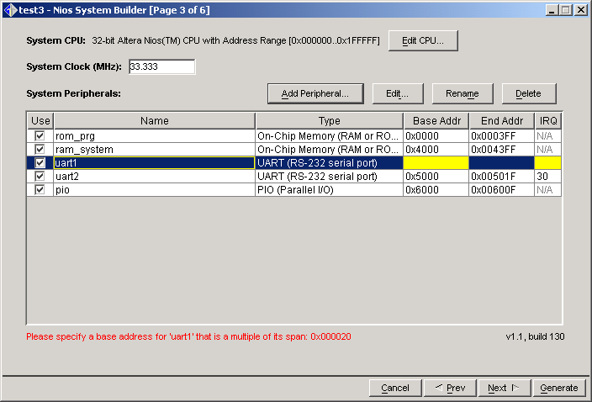
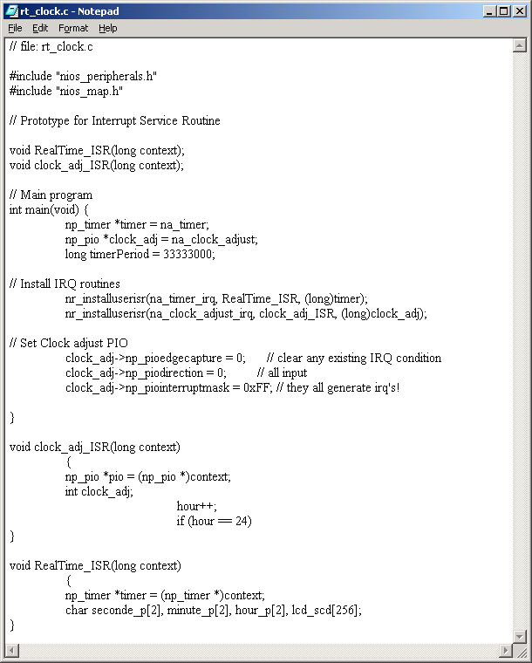
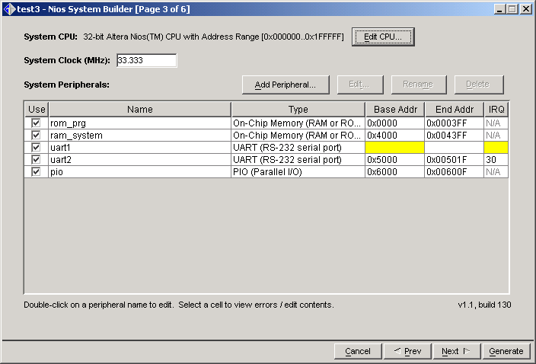
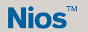
ISR Implementation
Specify your # IRQ
Declare your IRQ subroutines
Update the ISR vector table
ROM
instruction
@irq_subroutine 0
…
@clock_adj_ISR
@RealTime_ISR
…
@irq_subroutine 63
Vector Table
0xFFFF
…
0xFF0F
0xFF0E
…
0xFFC0
Write your IRQ Subroutine
Write your IRQ Subroutine
stack
RAM

Slide 8
How to disable or enable interrupt by soft
Control registers 8 and 9 must be written into (any value) to enable or disable IE bit of the status register (without affecting other bits of STATUS).
  ; Set IE=1 (Interrupts enabled);
  PFX 8
  WRCTL %g0 ; value of %g0 doesn't matter
  ; Set IE=0 (Interrupts disabled)
  PFX 9
  WRCTL %g0 ; value of %g0 doesn't matter

Slide 9
How to mask interrupt lines
Interrupts can be selectively enabled on a priority basis by the IPRI field in the STATUS register
  ;Read STATUS register
  RDCTL %g0 ; Loads %g0 from STATUS reg
  ;Apply mask value
  PFX %hi(0x81FF)
  AND %g0,%lo(0x81FF)
  ;Apply new IPRI value (20 for instance)
  PFX %hi(0x2800)
  OR %g0,%lo(0x2800)
  ;Write Status register
  WRCTL %g0
15
14 9
8 4
3
2
1
0
IE
IPRI
CWP
N
V
Z
C
1
0 0 0 0 0 0
1 1 1 1 1
1
1
1
1
IE
0 0 0 0 0 0
CWP
N
V
Z
C
0
0 1 0 1 0 0
0 0 0 0 0
0
0
0
0
IE
0 1 0 1 0 0
CWP
N
V
Z
C
Only interrupt number smaller than 20 will be processed

Slide 10
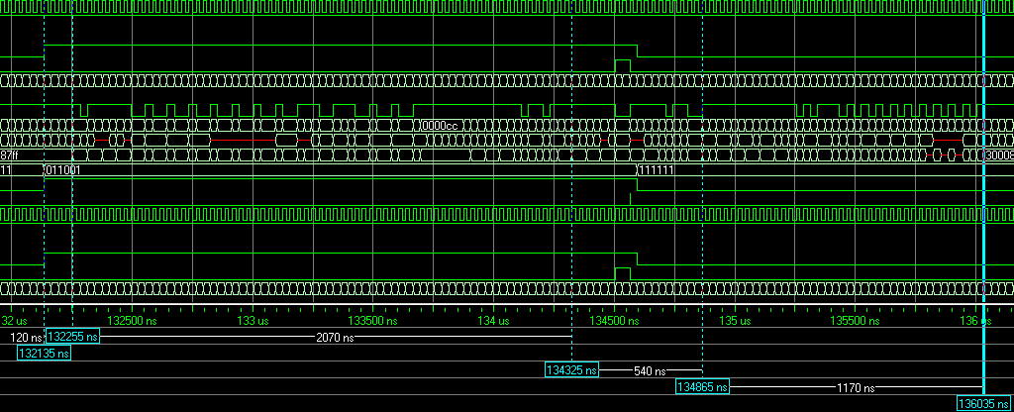
Interrupt switching performance
ISR switching time = 75 Clock cycles = 1.5µs at 50MHz
ISR releasing time = 40 Clock cycles = 800 ns at 50MHz
IRQ raised here
IRQ routine starts here
IRQ routine ends here
Main restarts here

Slide 11
NiosTM Advanced Training
SESSION I
Lab – Real Time Clock

Slide 12
Goals
Creating a Quartus II project
Generating a NiosTM System Variation
Writing & compiling a C Software Application Using an ISR
  Template will be provided
Simulating with Modelsim
Compiling with Quartus II
  Pin-Out file will be provided
Configuring the Nios board
Downloading & running the application
Creating a boot rom user application

Slide 13
The Nios System
ROM
Boot
RAM
system
RAM
Prg
Rx, Tx
UART
On-chip bus
TIMER
LCD PIO
Lcd_driver
Adj_hr
Adj PIO
Adj_mn
Adj_sc
On-System Nios

Slide 14
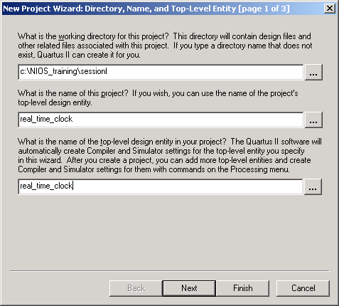
Creating a QuartusII project
Launch Quartus II
Open "File→New Project Wizard"
Fill the three following fields
  Working directory = "d:\training_nios\session1"
  Project Name = real_time_clock
  Top Level Name = real_time_clock
Clique on Finish
Open "File→ New…"
  Select Block Diagram/Schematic File
Open "File→Save as…"
  File Name = real_time_clock

Slide 15
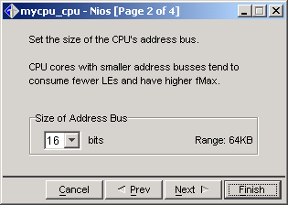
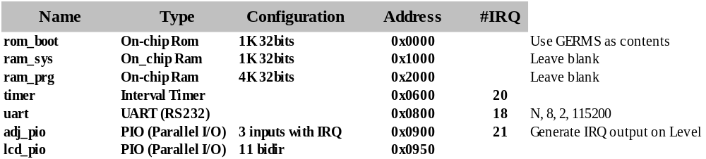
Generating a Nios System Variation 1/2
Launch the Nios Megawizard Plug-In Manager
  Double click in the Schematic Window
  Clique on the "MegaWizard Plug-In Manager…" button
  Select "Create a new custom megafunction variation"
  Select ALTERA Excalibur NiosTM megafunction
  Select Verilog HDL output type
  Give it the name mycpu
Do parameterise your core system
  Nios 32bits, 16bits @, 256 files reg., 3bits shifter, No MSTEP, No MUL

Slide 16
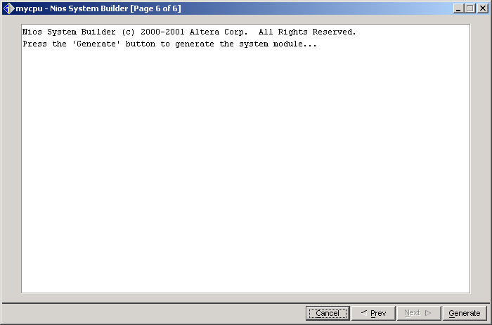

Generating a Nios System Variation 2/2
Nios system organisation
  Main Prog Memory = ram_prg
  Main Data Memory = ram_sys
  Host Communication = uart
  Debug Communication = uart
  Boot ID Message = Free to fill
  Boot Device = ram_prg
    For the simulation we will boot on the ram_prg which will be precharged.
    For real use, in the board, we will change the boot device to rom_germs
  Interrupt Vector Table = ram_sys
  Synthesis Target Familly = None
    For the simulation, we don't synthesis the core
Place the Nios system symbol in the schematic window
Save the schematic file as real_time_clock.bdf
"mycpu.ptf" file is generated which describes your whole Nios system

Slide 17
Writing & compiling a C Software Application using an ISR
In Windows Explorer, create the directory mysrc in
    D:\training_nios\session1\mycpu_sdk\
Copy the rt_clock.c file in
    D:\training_nios\session1\mycpu_sdk\mysrc\
Complete the program
  Insert ISR declaration
  Decrease the timer load value to 33333 in order to run faster the simulation
Open a Bash Window & Go in
    D:\training_nios\session1\mycpu_sdk\mysrc\
Run "NIOS-BUILD rt_clock.c" to generate compiled Code
  rt_clock.srec
  rt_clock.objdump

Slide 18
PTF file modification
Open mycpu.ptf file with your Favorite Editor in
    D:\training_nios\session1\
Turn on simulation support file generation by setting variable do_build_sim to 1 as follows:
    SYSTEM mycpu
    {
    WIZARD_SCRIPT_ARGUMENTS
    {
    do_build_sim = "1" ;
ram_prg user file specification
  Find the MODULE ram_prg section and Change the following lines
WIZARD_SCRIPT_ARGUMENTS
{
Writeable = "1";
Contents = "user_file";
Initfile = "mycpu_sdk\\mysrc\\rt_clock.srec";
}

Slide 19
Generating the Simulation environment
Open a BASH window and go in "D:\training_nios\session1"
Run the following command
  GENERATE_PROJECT mycpu
  Only verilog files are generated at this point.
VHDL files generation
  Go in "D:\training_nios\session1\mycpu_sim"
  Run VHDL_SIMULATION mycpu_test_bench.v > compile_vhdl.do

Slide 20
Creating a Modelsim Script
VHDL Edit the compile_vhdl.do file
  Remove the initial header lines,
  leaving only the file names
  Add "vcom -work work" for each line
  Re-Order memory files included
    Memory Lanes have to be declared before the
    memory top level definition
  Add "vsim work.mycpu_test_bench"
You should get the following macro file
Compile_vhdl.do
vcom -work work ./nios_cpu_dr.vhd
vcom -work work ./nios_cpu_ar.vhd
vcom -work work ./nios_cpu_cr.vhd
vcom -work work ./nios_cpu_register_ram.vhd
vcom -work work ./nios_cpu_major_opcode_table.vhd
vcom -work work ./nios_cpu_subtable_w.vhd
vcom -work work ./nios_cpu_instruction_decoder.vhd
vcom -work work ./nios_cpu_cpu_core.vhd
vcom -work work ./timer.vhd
vcom -work work ./lcd_pio.vhd
vcom -work work ./rom_prg.vhd
vcom -work work ./ram_sys_lane_0.vhd
vcom -work work ./ram_sys_lane_1.vhd
vcom -work work ./ram_sys_lane_2.vhd
vcom -work work ./ram_sys_lane_3.vhd
vcom -work work ./ram_system.vhd
vcom -work work ./nios_rg.vhd
vcom -work work ./nios_pbm.vhd
vcom -work work ./nios_core.vhd
vcom -work work ./test_equipment.vhd
vcom -work work ./mycpu_test_bench.vhd
vsim work.mycpu_test_bench

Slide 21
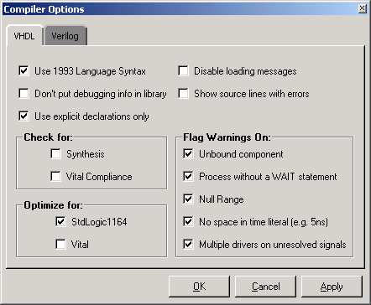
Simulating with ModelSim 1/4
Launch Modelsim Altera-Edition or SE 5.4
Open "File→Change directory.." menu and select "D:\training_nios\session1\mycpu_sim"
Open the "Options→Compiler.." menu
  Disable "Check for Vital Compliance"
  Disable "Optimize for Vital"
  Enable "Use 1993 Language Syntax"
Type "do compile_vhdl.do" in the command line
Open the "View→Structure" menu
Open the "View→Signal" menu

Slide 22
Simulating with ModelSim 2/4
Select the following signals:
  /mycpu_test_bench/the_mycpu_core/clk
  /mycpu_test_bench/the_mycpu_core/reset_n
  /mycpu_test_bench/the_mycpu_core/the_timer/irq
  /mycpu_test_bench/the_mycpu_core/the_timer/timer_select
  /mycpu_test_bench/the_mycpu_core/the_timer/internal_counter [set the radix format to dec]
  /mycpu_test_bench/the_mycpu_core/the_mycpu_cpu/ifetch
  /mycpu_test_bench/the_mycpu_core/the_mycpu_cpu/mem_addr [set the radix format to hex]
  /mycpu_test_bench/the_mycpu_core/the_mycpu_cpu/data_from_cpu [set the radix format to hex]
  /mycpu_test_bench/the_mycpu_core/the_mycpu_cpu/data_to_cpu [set the radix format to hex]
In the Waves window, open "Edit→Display Properties…"
  Set to 1 the Signal Names path elements displayed
In the Waves window, Save your waves format as wave.do
Open the "Options→Simulation..." menu and enable "Suppress Warning" for both Synopsys and IEEE packages.
Type "run 1ms" in the command line

Slide 23
Simulating with ModelSim 3/4
Open the "rt_clock.objdump" file in D:\training_nios\session1\mycpu_sdk\mysrc\
Find the address of
  Main program = _______
  The beginning of the Real_time_ISR sub-routine = _______
  The end of the Real_time_ISR sub-routine = _______
In the Modelsim Waves window, add cursors
  On the Rising edge of the Timer IRQ = t_{IRQ}
  At the beginning of the Real_time_ISR sub-routine = t_{b}
  At the end of the Real_time_ISR sub-routine = t_{e}
  At the @ when the Main program start again = t_{s}
Fill the following time.
  ISR switching time = t_{b}-t_{IRQ} =______
  ISR release time = t_{s}-t_{e} =_______

Slide 24
Simulating with ModelSim 4/4
Re-Simulating each times the SW Has Been Modified
Open a Bash Window & Go in
    D:\training_nios\session1\mycpu_sdk\mysrc\
Run "NIOS-BUILD rt_clock.c" to generate compiled Code
Open a BASH window and go in "D:\training_nios\session1"
Run the following command
  GENERATE_PROJECT mycpu
VHDL files generation
  Go in "D:\training_nios\session1\mycpu_sim"
  Run VHDL_SIMULATION mycpu_test_bench.v

Slide 25
Re-Generating the Nios system 1/2
& Producing an EDIF file
Open the "rt_clock.c" file and perform the following changes
  Uncomment the lines about LCD_driver
    #include "pio_lcd16207.h"
    nr_pio_lcdinit(na_lcd_pio);
    nr_pio_lcdwritescreen("NIOS CLOCK TIMER");
    All the lines in the RealTime_ISR between /* … */
  Increase the TimerPeriod Value to 33333000
Open a Bash Window & Go in
    D:\training_nios\session1\mycpu_sdk\mysrc\
Run "NIOS-BUILD rt_clock.c" To Generate Compiled Code
  rt_clock.srec
  rt_clock.objdump

Slide 26
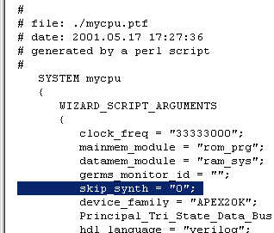
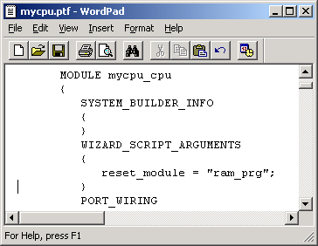
Re-Generating the Nios system 1/2
& Producing an EDIF file
Edit file mycpu.ptf in "D:\training_nios\session1"
Enable the synthesis by putting
"skip_synth" option to 0
Change the boot device memory by "rom_boot"
which contents the GERMS monitor
  Find the topic reset_module in WIZARD_SCRIPT_ARGUMENT of the MODULE mycpu_cpu
Open BASH window and go in "D:\training_nios\session1"
Run the following command
  GENERATE_PROJECT mycpu

Slide 27
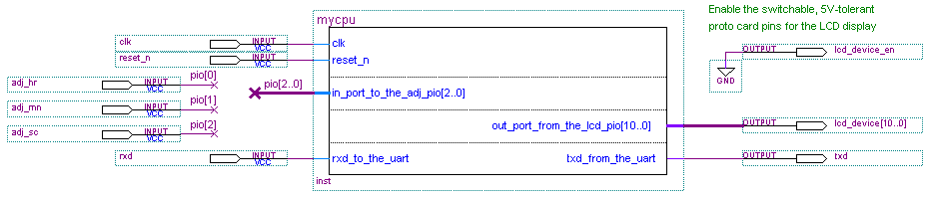
Compiling w/ Quartus II 1/3
Under Quartus, double click in the schematic window
  The Symbol manager is launched
Type Input in the Name field and clique OK
Copy and past n times the Input symbol and connect all the input ports of the Nios symbol
Place a Output symbol in front of each output ports
Add an extra output as the lcd_device enable and force it at 0
Double Clique on each Input/Output symbol and change the name as shown hereafter

Slide 28
Compiling w/ Quartus II 2/3
Select the APEX device type
  Open "Processing→Compiler Settings…"
  Select "Chips & Devices" tab
  Select Family APEX20KE and select EP20K200EFC484-2*
  Clique on "Device & Pin Options" button
  Select "Unused Pins" tab and select Reserve all unused pins
  "As inputs, tri-stated"
  Clique OK 2 times.
* Please check on your board to know the exact 20K device mounted on it

Slide 29
Compiling w/ Quartus II 3/3
Assign I/O pins accordingly to the Nios demo board features
  Close the project by selecting "file→Close Project"
  Under Windows Explorer open real_time_clock.csf file in "D:\training_nios\session1" and add the I/O assigment in the CHIP session as shown hereafter:
CHIP(real_time_clock)
{
clk : LOCATION = Pin_L6;
reset_n : LOCATION = Pin_F12;
adj_hr : LOCATION = Pin_Y9;
adj_mn : LOCATION = Pin_T9;
adj_sc : LOCATION = Pin_Y8;
lcd_device[0] : LOCATION = Pin_U21;
lcd_device[10] : LOCATION = Pin_N15;
lcd_device[1] : LOCATION = Pin_P17;
lcd_device[2] : LOCATION = Pin_U1;
lcd_device[3] : LOCATION = Pin_U2;
lcd_device[4] : LOCATION = Pin_T2;
lcd_device[5] : LOCATION = Pin_T3;
lcd_device[6] : LOCATION = Pin_U4;
lcd_device[7] : LOCATION = Pin_U19;
lcd_device[8] : LOCATION = Pin_R18;
lcd_device[9] : LOCATION = Pin_W20;
lcd_device_en : LOCATION = Pin_V7;
rxd : LOCATION = Pin_W8;
txd : LOCATION = Pin_D15;

Slide 30
Configuring the Nios board
Re-open the real_time_clock project
  The I/O assignments are now taken into account
Start the compilation by selecting
"Processing→Start compilation"
The compilation time takes about 6 minutes
Open "Processing→Open Programmer" menu
  Clique "Add file" and select real_time_clock.sof file
  Enable "Program/Configure" box
  Start the configuration

Slide 31
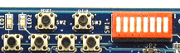
Downloading & running the application
Open BASH window and go in
"D:\training_nios\session1\mycpu_sdk\mysrc"
Download the SREC file by typing
"NIOS-RUN rt_clock.srec"
Now, your application is running
APEX hard Reset
NIOS soft Reset
Adj_hr
Adj_mn
Adj_sc

Slide 32
Adding feature in the C application
Open the file rt_clock.c
Add the adj_pio ISR in order to manage the update of
  Hours,
  Minutes,
  Seconds
Open a Bash Window & Go in
    D:\training_nios\session1\mycpu_sdk\mysrc\
Run "NIOS-BUILD rt_clock.c" To Generate Compiled Code
Reset the Nios system in order to go back in the GERMS monitor
Download the srec file by typing "NIOS-RUN rt_clock.srec"

Slide 33
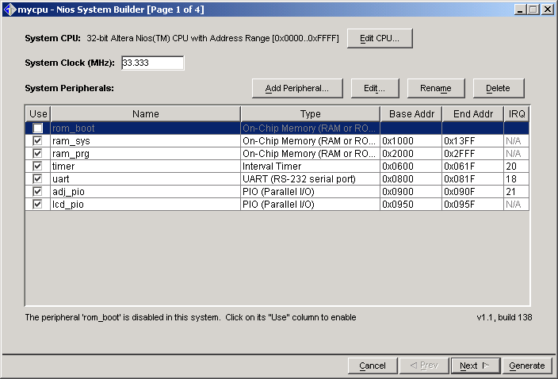
Creating a boot rom user application
Under Quartus, in the schematic window, double click on the Nios system symbol
Disable the rom_boot and change the ram_prg as ROM
Re-Generate the Nios system
Re-compile under Quartus
In the BASH, type "NIOS-RUN –t"
to be in terminal mode
Re-load the configuration
  The CPU will reset on the GERMS monitor and you will see the ID displayed

